Slide 1



Menopause and mental health - why workplaces must act now
Tuesday 21st October 2025

Slide 2

Who we are
Charlotte
Maxwell-Davies
Head of Workplace Mental Health
& Training at Mental Health UK

Slide 3



We are the charity for everyone’s mental health.
Who we are
We challenge the causes of poor mental health and give people the tools they need to live their best possible life at home, school and work.
In a rapidly changing world, we bring together the heritage and experience of four charities from across the country who’ve been supporting people with their mental health for over 50 years.

Slide 4

This webinar will cover:
Why urgent action is needed to improve support around menopause and mental health in the workplace
What effective, supportive action looks like in practice
How business, employers, and colleagues can implement
meaningful changes to support those affected.

Slide 5
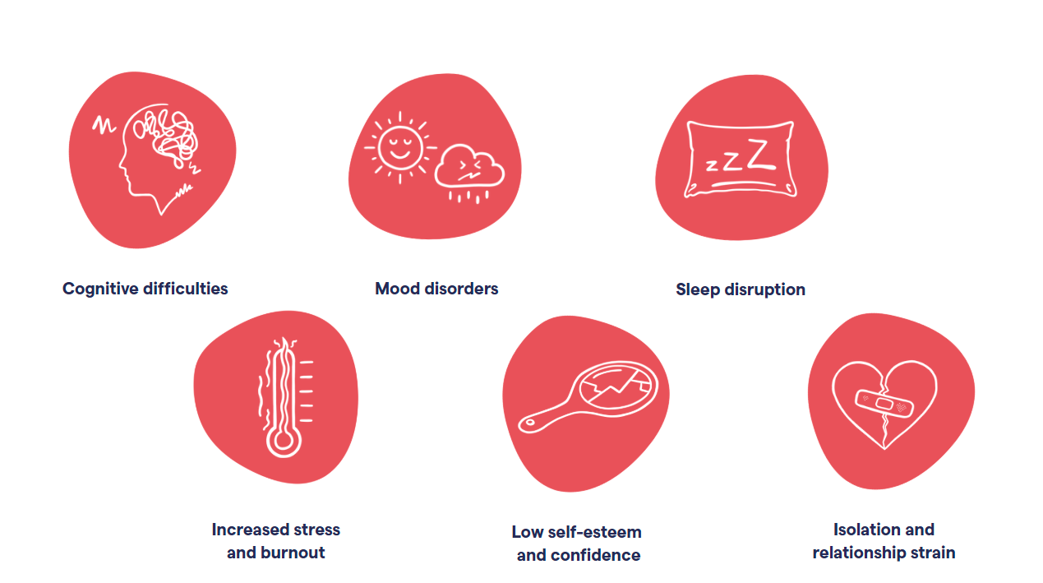
60% experience mental health challenges

Slide 6

The workplace
impact
5 million women ages over 50 in employment
8 in 10 menopausal women are in work
3 in 4 women experience menopausal symptoms, with 1 in 4 considering leaving their jobs
14 million working days are lost annually due to menopause
Cost to UK businesses estimated at £7.3 billion annually through absenteeism etc
Menopause-related employment tribunals doubled in recent years

Slide 7
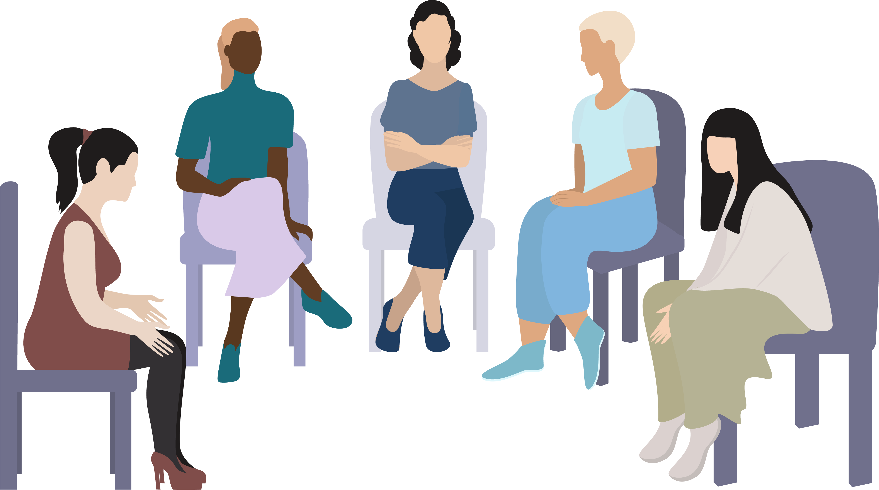
MHUK training will cover:
Understand the impact of menopause on mental health
Feel more confident having supportive conversations in the workplace
Learn about available support and resources
Contribute to a more inclusive and
psychologically safe environment

Slide 8
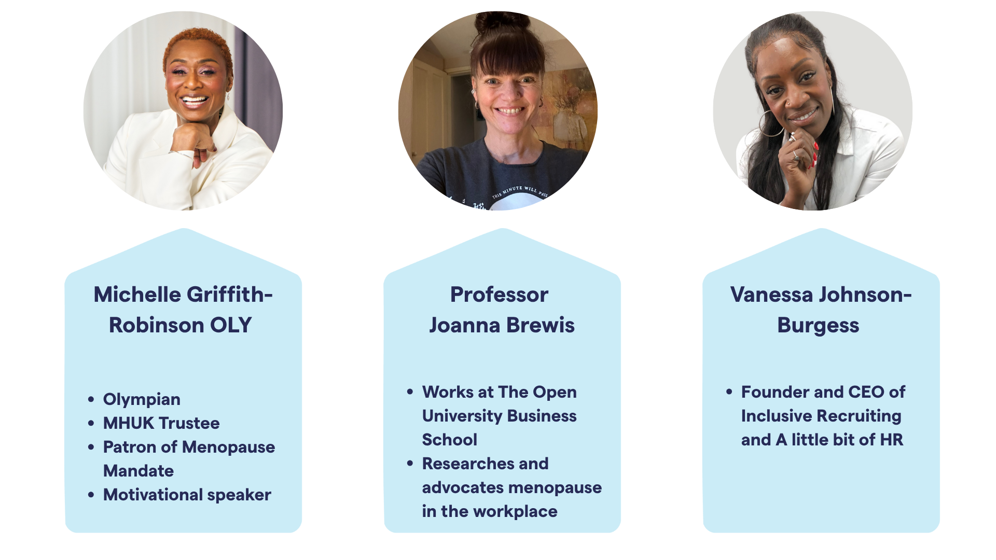

Slide 9
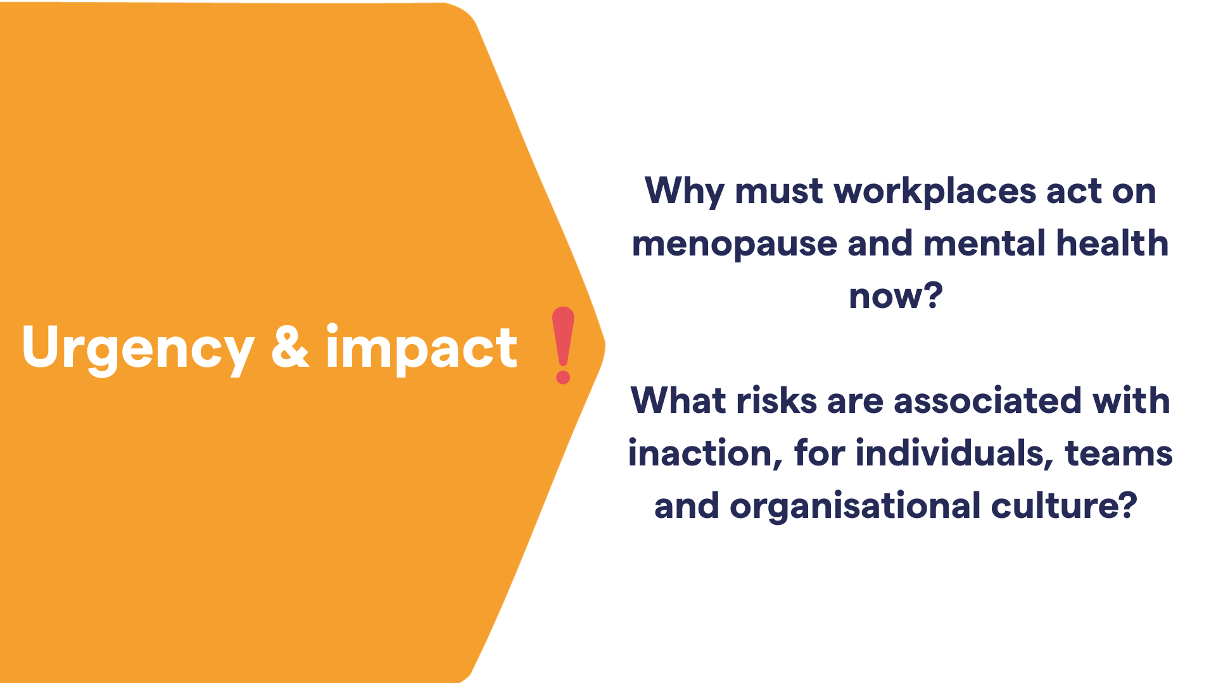


Slide 10
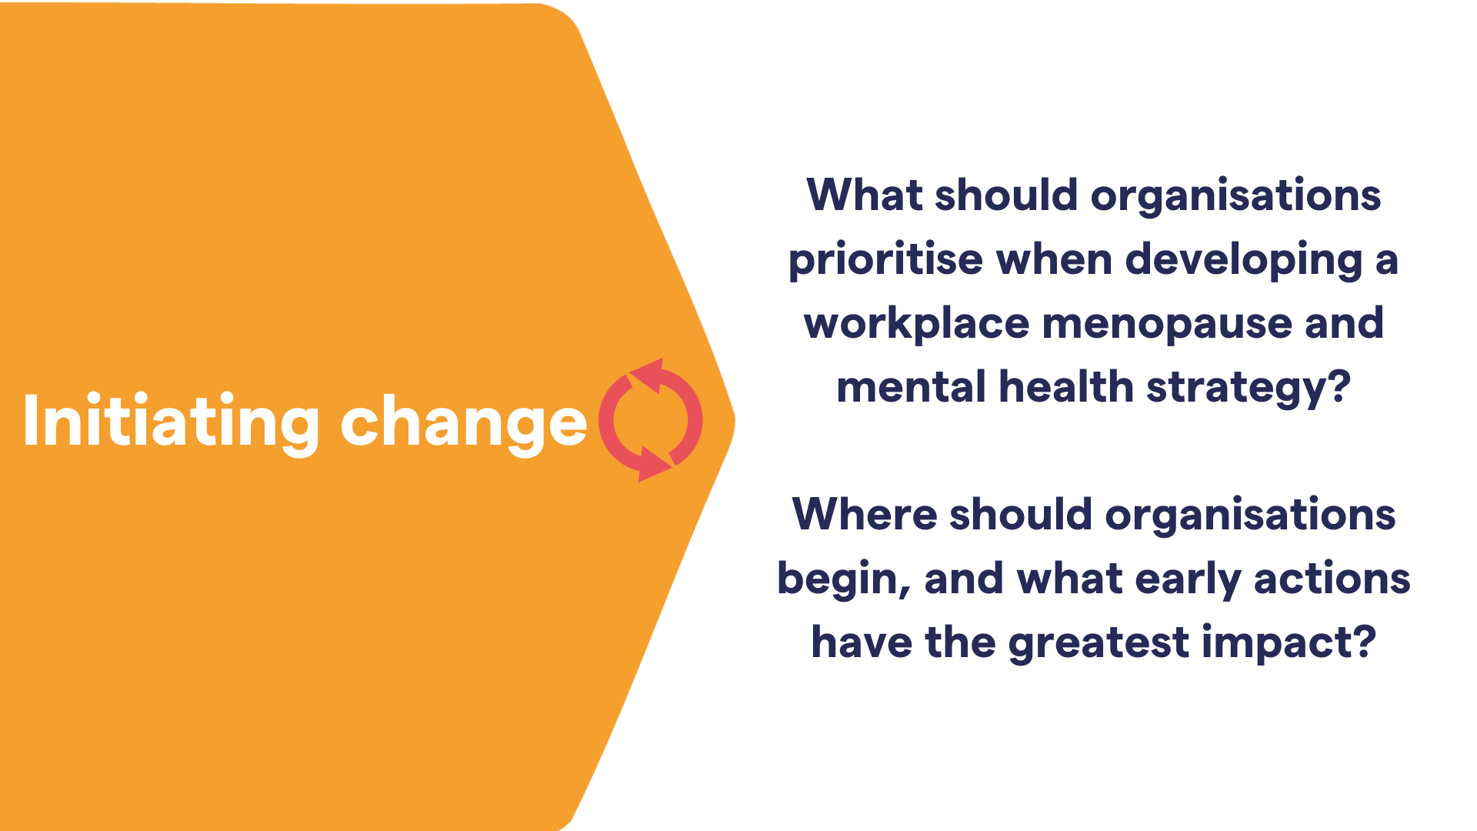
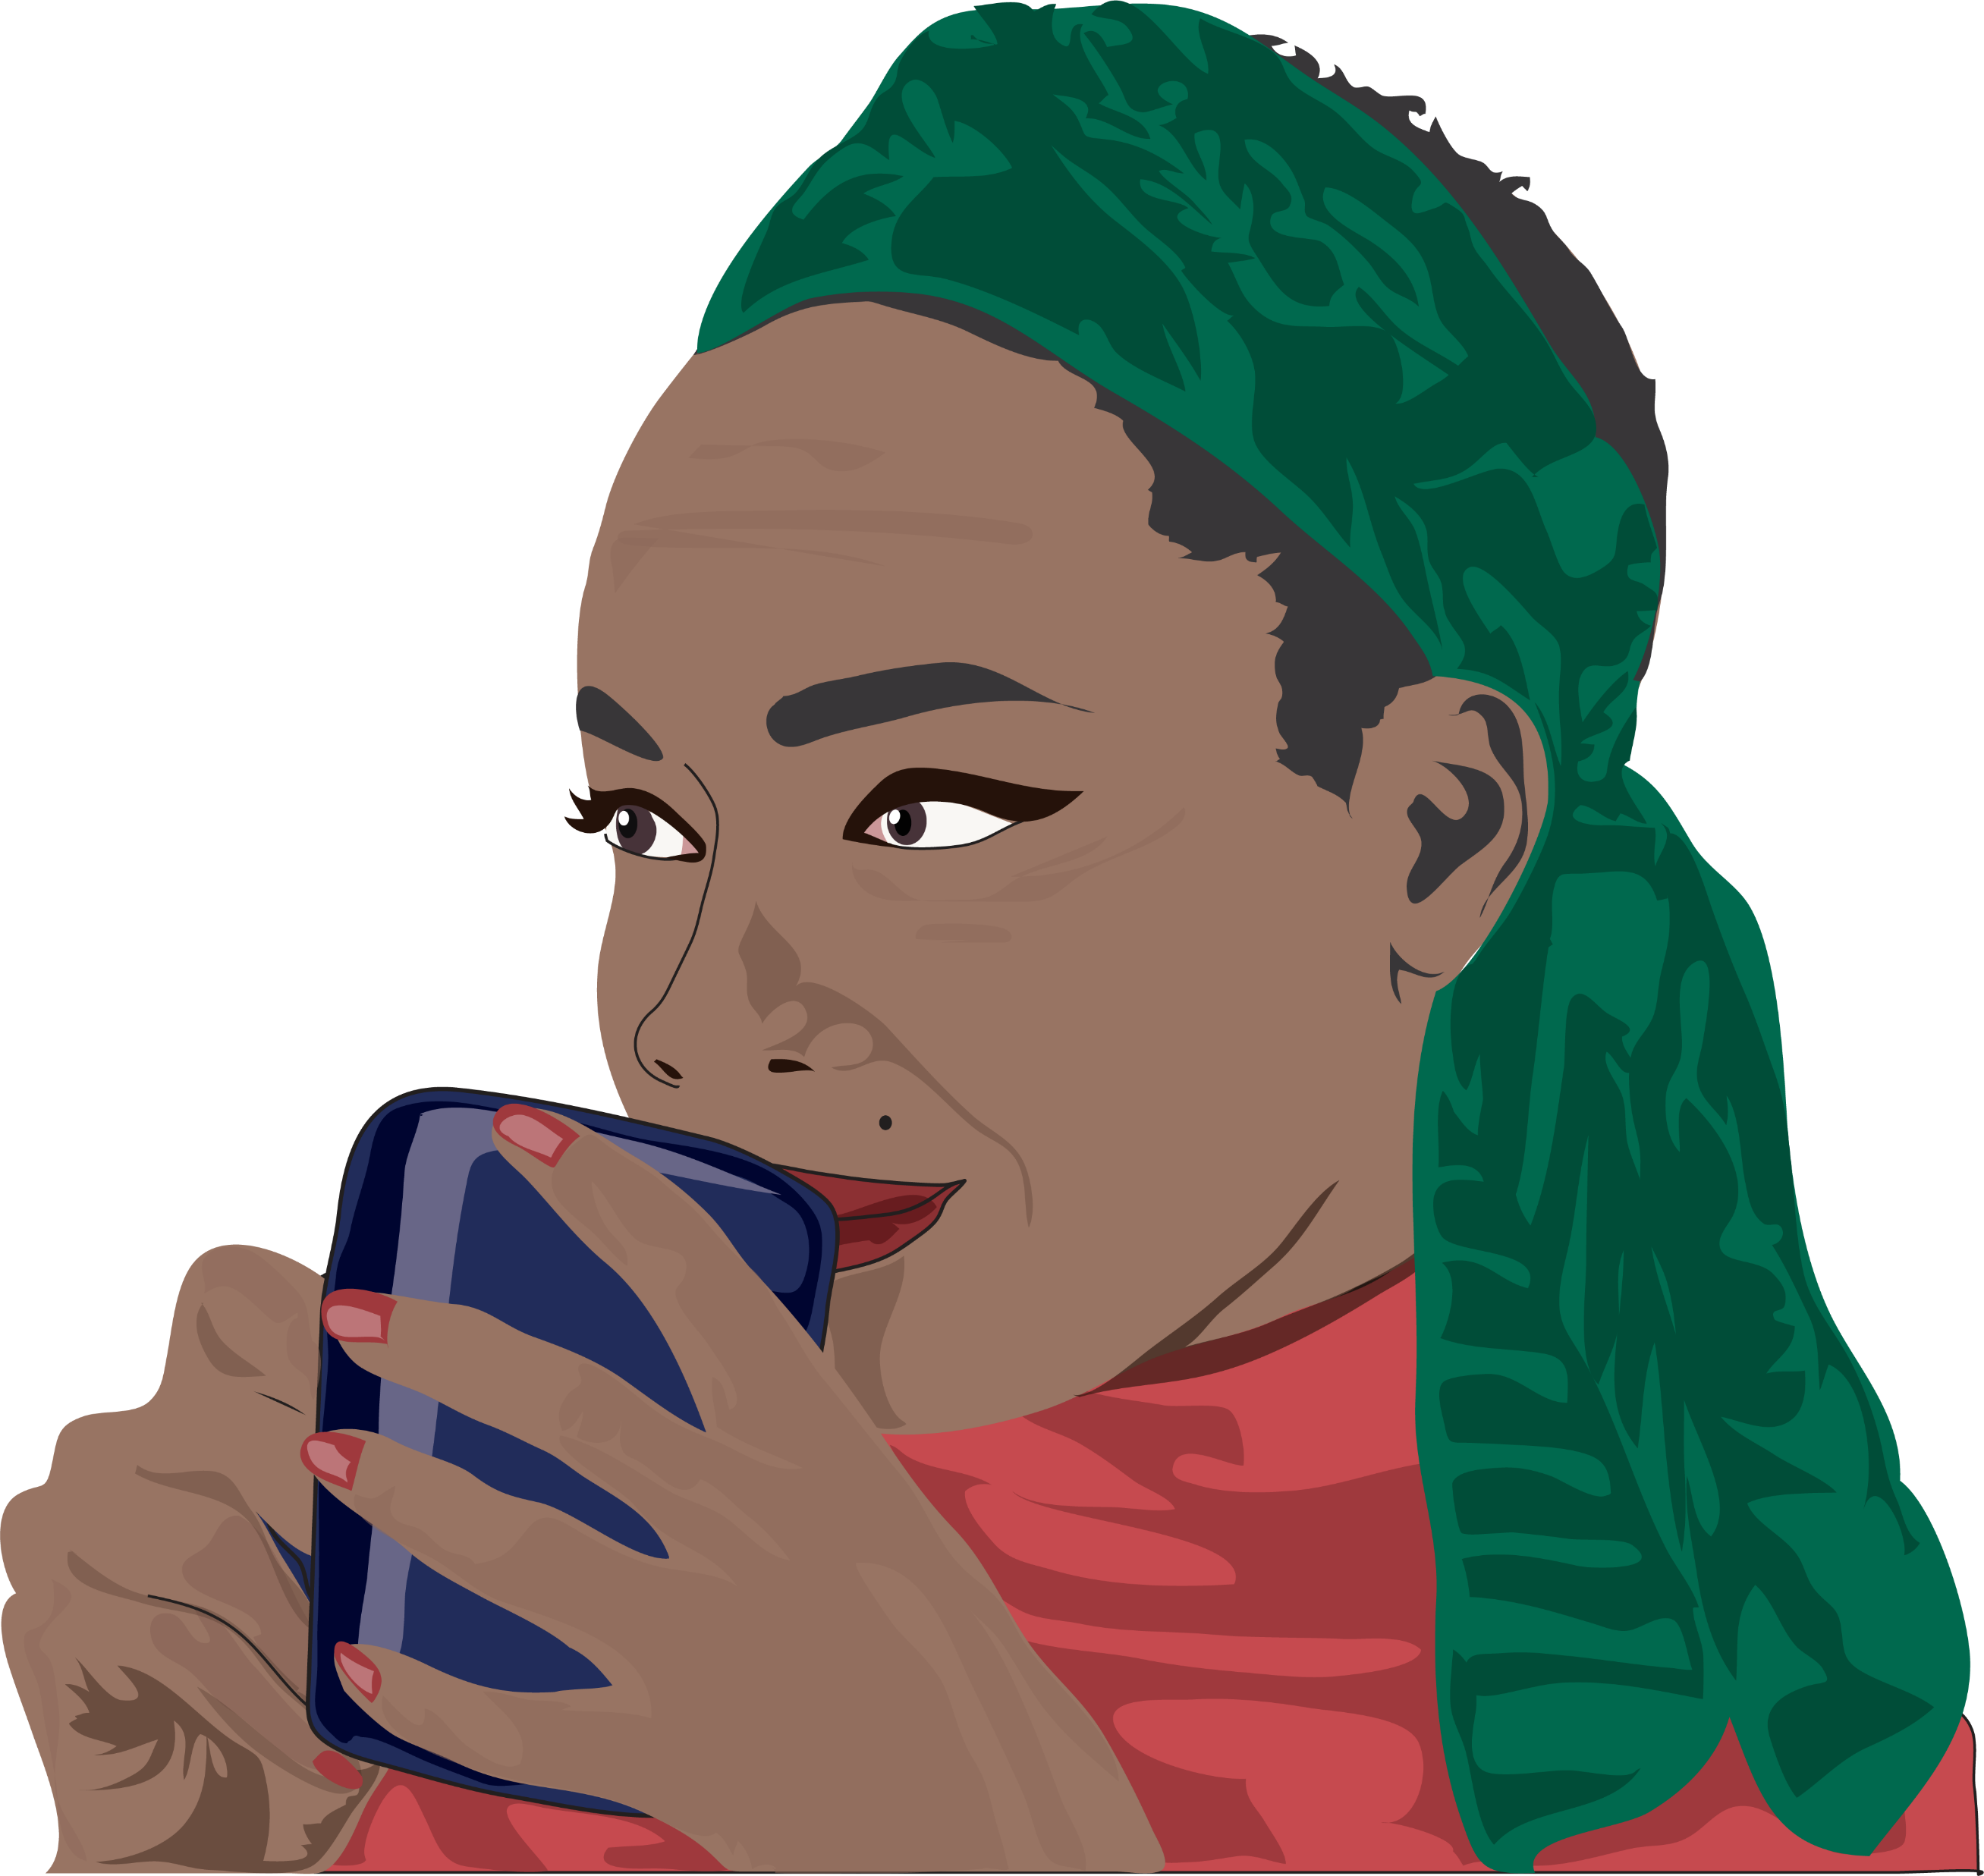

Slide 11
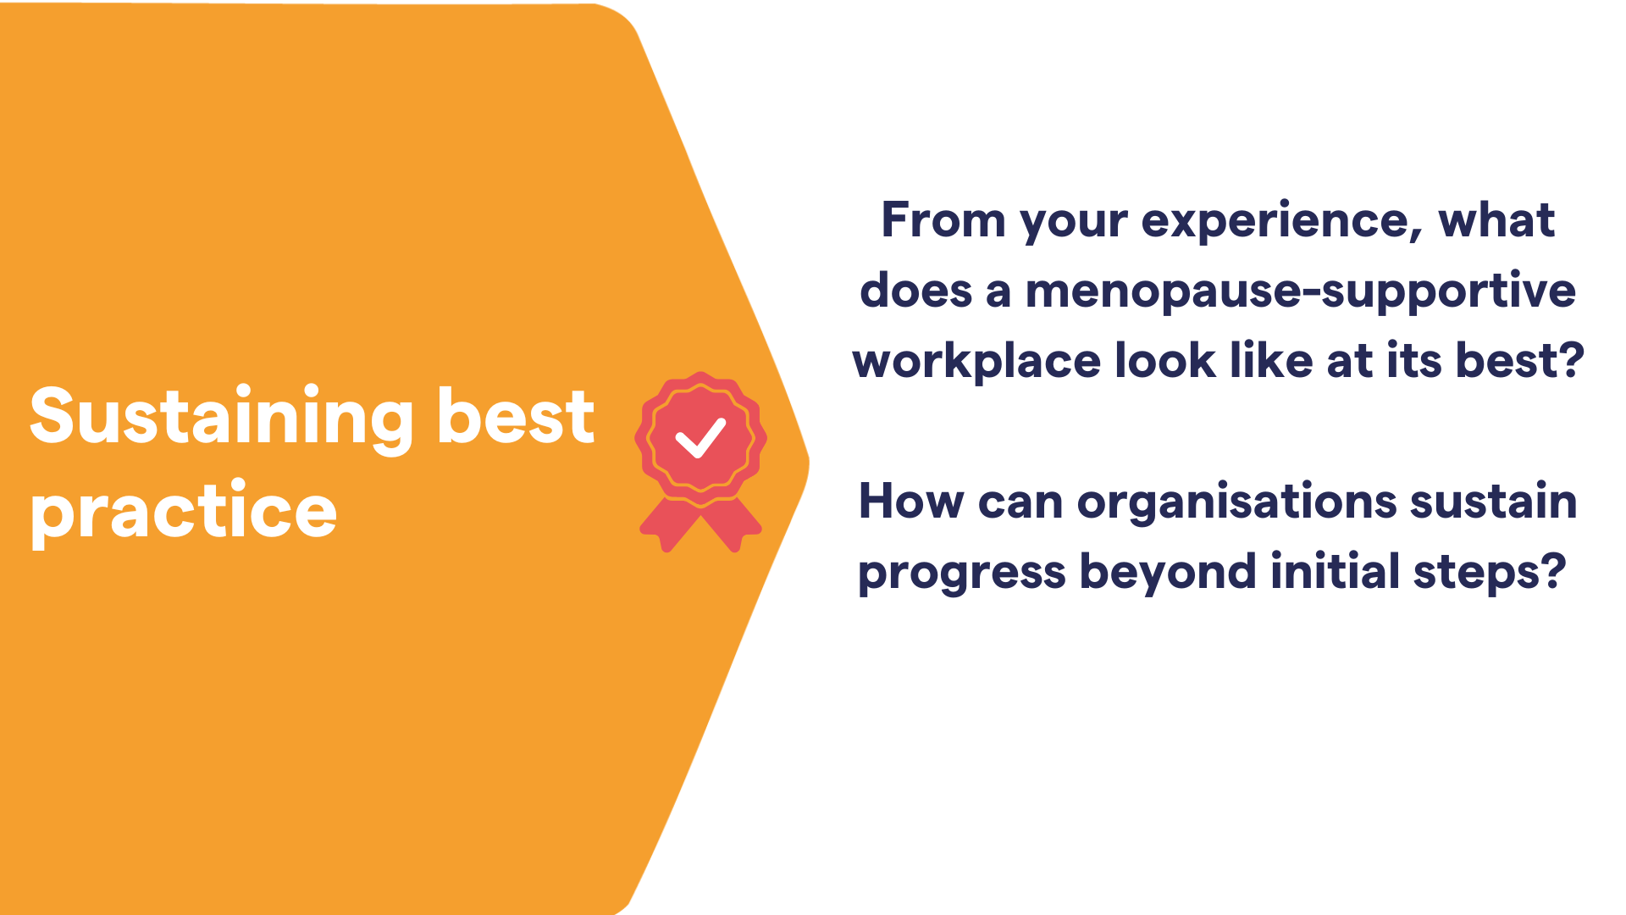


Slide 12







Thank you!
F: @MentalHealthUK
Li: /MentalHealthUK
In: @mhealthuk
mentalhealth-uk.org

