Slide 1



Uncovering
menopause and
mental health
in the workplace
Tuesday 15th July 2025

Slide 2

Who we are
Charlotte
Maxwell-Davies
Head of Workplace Mental Health
& Training at Mental Health UK

Slide 3



We are the charity for everyone’s mental health.
Who we are
We challenge the causes of poor mental health and give people the tools they need to live their best possible life at home, school and work.
In a rapidly changing world, we bring together the heritage and experience of four charities from across the country who’ve been supporting people with their mental health for over 50 years.

Slide 4
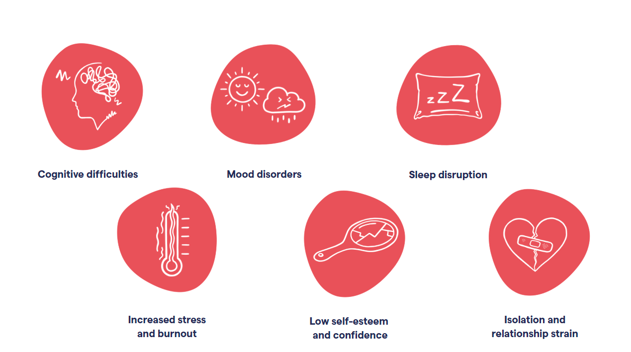
Menopause and mental health

Slide 5

The workplace
impact
8 in 10 menopausal women are in work
3 in 4 women experience menopausal symptoms, with 1 in 4 considering leaving their jobs
14 million working days are lost annually due to menopause
Cost to UK businesses estimated at £7.3 billion annually through absenteeism etc
Mental health challenges during menopause affect up to 60% of women
Menopause-related employment tribunals doubled in recent years

Slide 6

Emma Carrington
Head of Rethink Advice and
Information Service

Slide 7

Symptoms
Brain fog
Poor concentration
Tiredness
Anxiety and panic attacks
Increased migraine attacks
How my symptoms affect me at work
Effects
Loss of my ‘super power’
Loss of confidence
Time off - guilt
Feeling overwhelmed
Imposter syndrome

Slide 8

Learning about the menopause
Talking to my line manager, direct reports and team about how menopause affects me and my work
Using tools that make it easier for me to concentrate on whats happening in a meeting eg note taker apps
Asking for what I need
Peer support groups
Flexibility
What helped?

Slide 9
A knowledge bank of things that can help
Mis-understanding from other people
Sickness absence policies that take account of conditions like the menopause
Recognition of how important it is to make time for peer support meetings
What was missing?

Slide 10

Heather Nyoni
Menopause Coach

Slide 11

Culture, policy and accountability
• Breaking the stigma in workplace culture
• What meaningful support looks like
• Pitfalls of one-off interventions
• How to embed change in policy and culture

Slide 12

The Impact of Silence
98%
8%
Workplace Impact
Support Received
Menopause affected their job
Received training/support
And in that silence… women are quietly breaking down!

Slide 13




Culture Is What Happens...
When a woman says: 'I'm struggling…'
And the response is: 'Push through.'
Women hide symptoms
Brain fog, memory loss, anxiety
Shame leads to silence
Silence leads to women exiting

Slide 14
The Impact of Silence
61%
52%
Workplace Impact
Career Impact
No workplace adjustments
Hurt their career
13%
Left Work
Left work altogether
'I feel like a walking zombie… I don't recognize who I've become.'

Slide 15

The Cost to Business
Systemic neglect is expensive
Panic, absenteeism, resignation
Estimated cost: £7.3 billion/year
(Fawcett Society 2023)
This is not about resilient workforce —
it's about broken systems.

Slide 16





Real Support Means...
Trained managers
Managers who understand menopause symptoms and
appropriate responses
Reasonable adjustments without fuss
Accommodations that are readily available and normalized
HR language that reflects reality
Policies that acknowledge the true impact of menopause
Support that's structural, not decorative
Meaningful changes to workplace culture and systems
You can't HRT your way out of a toxic culture.

Slide 17
Your Role in This
If you manage – ask:
If you're a colleague – know:
Would I recognize brain fog or distress?
Menopause awareness builds empathy
Would she trust me to believe her and do right by her?
Lack of understanding builds resentment

Slide 18






What Change Looks Like
Budget-backed support
Financial commitment to menopause initiatives and reasonable accommodations
Open conversations
Creating safe spaces for honest dialogue about menopause experiences
Track impact and retention
Measuring outcomes to ensure effectiveness of support systems
One supported woman lifts her workplace, her family, her community.

Slide 19

Broader Perspective
1
Early Onset
Menopause can begin earlier in some women
2
Duration
May last 7–10+ years
3
Diverse Experiences
Not just women 45–55
Support must include all: race, health, age and roles

Slide 20

Final Thought
Change starts in rooms like this
If you set the tone, you set the standard
Change doesn’t start from a corporate strategy it starts like this : 'I see what's happening — and I won't stay silent.’
A young woman, 20 years from now, entering her first job.
She already knows that menopause isn’t a career death sentence.
She knows she’ll be
Seen…
Heard…
Supported…
She knows it because YOU and I changed the system!

Slide 21
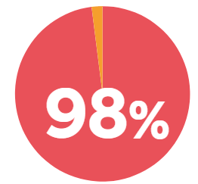
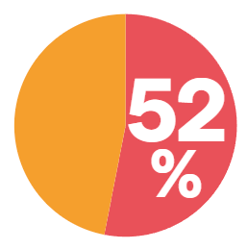


menopause symptoms have impacted their ability to do their job
Menopause
survey insights
feel the menopause could have or has had a negative role in shaping their career experience or opportunities
had to stop working because of
menopause-related challenges

Slide 22





61%
stayed in their role with no change/adjustments despite experiencing menopause-related challenges
22%
felt comfortable discussing their symptoms with their manager or HR
49%
said their employer did not offer any support for their menopause symptoms
16%
reasonable adjustments were made for them by their employer
8%
workplace has provided training on menopause and mental health

Slide 23
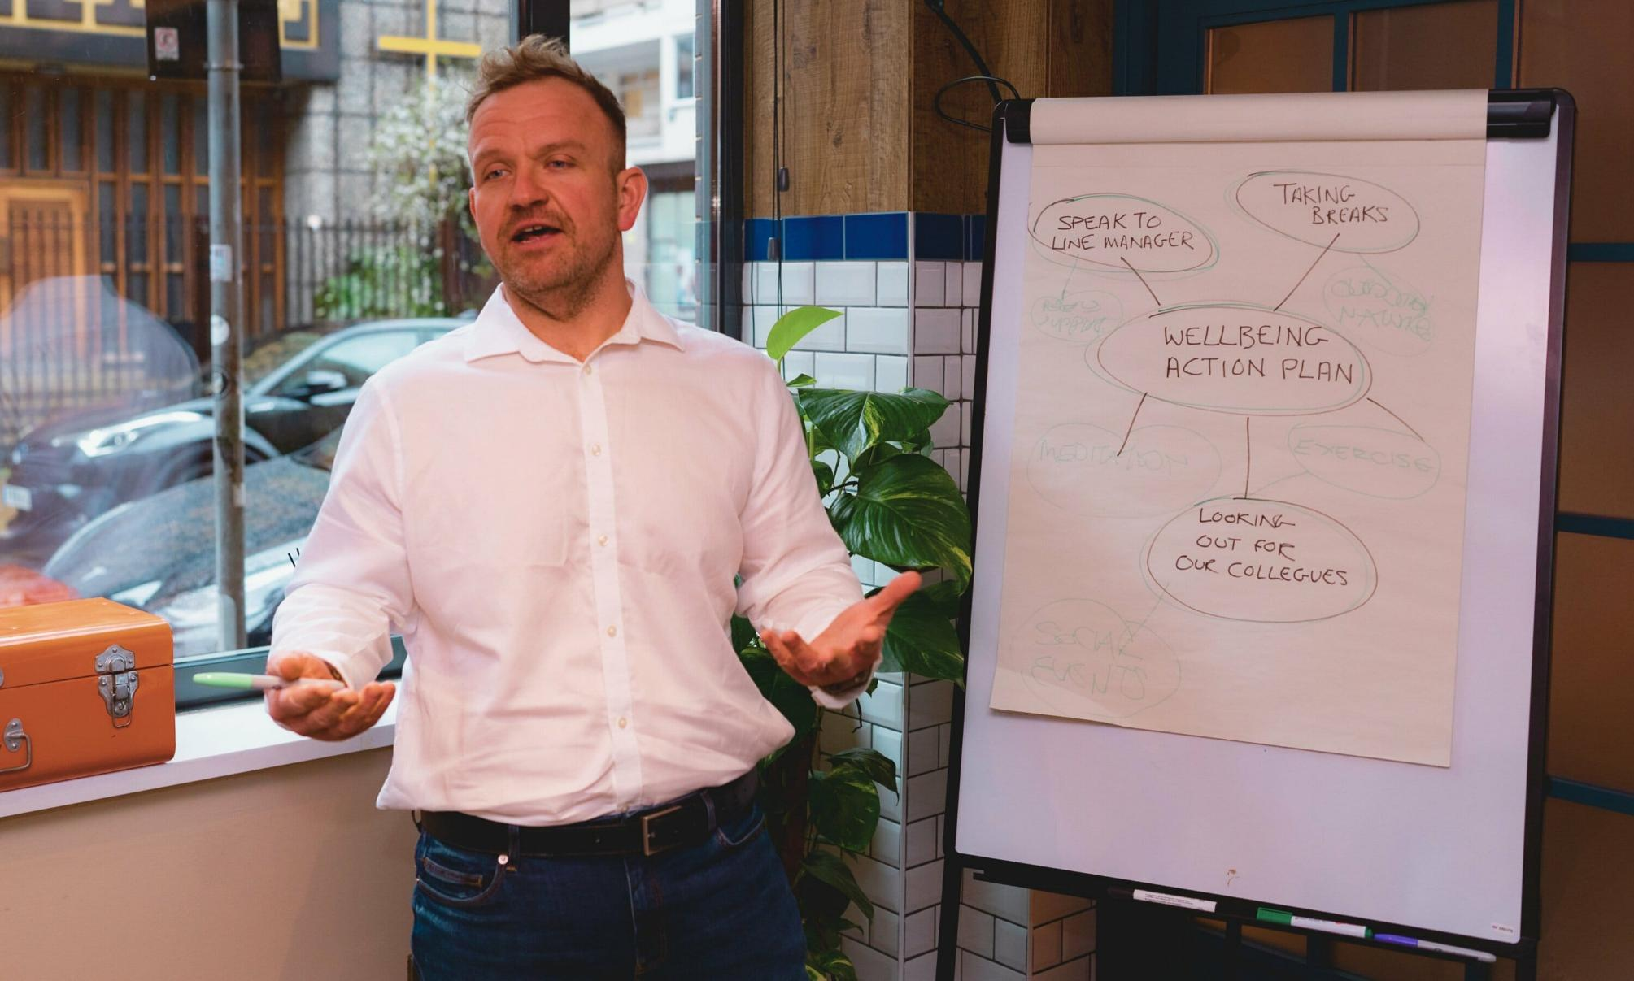

Our training offer

Slide 24

Topics covered in our training
• Menopause & Mental Health: Connections and symptoms overview
• Practical Techniques: Stress management, sleep hygiene, lifestyle habits
• Workplace Considerations: Reasonable adjustments and colleague/employer roles
• Accessing Help: Navigating support services and community resources

Slide 25


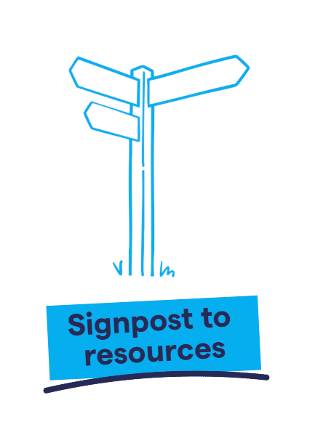

Thank you!
F: @MentalHealthUK
Li: /MentalHealthUK
In: @mhealthuk
mentalhealth-uk.org

